Slide 1
MXB344: GLMs
Josh Lim n9776435
Vinnie Ng n9648411
Joseph Grech n9734902
Dominic Chow n9621351

Slide 2
Context & Objective
Obtain clear understanding on current and evolving methodologies on credit risk modelling
Determine key variables after data cleansing
Decide on several models after extensive testing on dataset
Compare models through cross-validation techniques and benchmark tests
Conduct comparison with variables from given BoQ model
Draw up conclusions and possible improvements
Notes:
We are a team of analysts tasked with the rebuild of the credit risk model that BoQ has using specifically Generalised Linear Models. Having been given approximately 6 weeks to conduct our research, our team has done extensive study on methods involved to clean data, determine key variables through heuristics and prior models, building and testing of several models before comparisons and deciding which model provides best fit

Slide 3
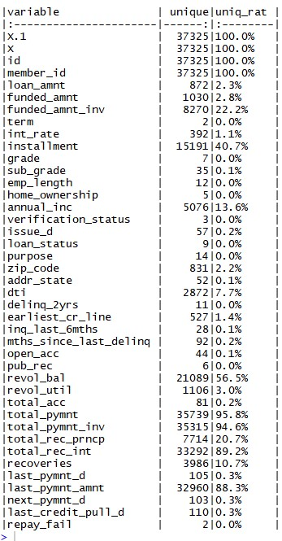
Exploratory Analysis
Initial default rate found to be approximately 18%
A variable that holds more than 30% unique values may not ideal to be use for modelling due to the expansion of overall variability .
Notes:
Dom

Slide 4
Literature Review
Traditional Models | Modern Models
Tools consist of Logistic Regression, Naïve Bayes, etc. | Tools consist of Neural Networks, Recursive Partitioning Models, Radial-Basis Functions, Fuzzy Logic, etc.
Heavily based on historical data/samples, Boolean logic | Involves use of out-of-sample forecasts, makes use of consumer behavior data, uses fuzzy inference systems, etc.
Based on static loss assumptions | Use of segmented markets
Focused on systematic risk components | Integrated platform use
Open to human bias due to manual processes | Expansive use of automated processes
Manual processes bring heavy cost, slow decisions | Adaptive with anomaly detection and predictive analytics uncovering new forms of risk at any given time
Goals: Speed, Precision, Confidence
Avoid selection bias
Check for multicollinearity
Attempt using Random Forests and Least Absolute Shrinkage and Selection Operator (LASSO) regression
Table 1: Characteristics of Current vs Modern Evolving Tools
Notes:
Dom
Speed, precision, confidence (inspired by balance between risk aversion, business development and transparency in model rigor)
Sample selection bias, consider reject inference
Variable importance, apply heuristics to analysis
Check for multicollinearity as an independence test
Test using random forests

Slide 5
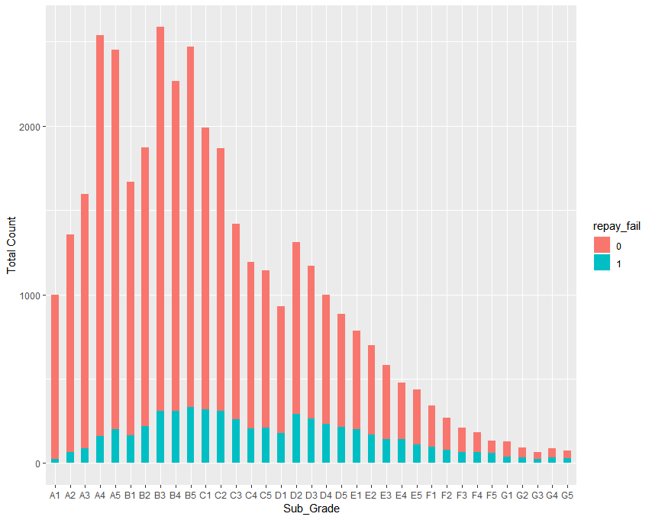
Exploratory Analysis
Subgrade is clustered according to grades and show interesting,differing patterns. Potential bias?
Notes:
Dom
A and B increase along 1 to 5 but for C, D, E, F and G show steady decreases. Bias in that subgrade ratings A and B always get approved for loans(?) Look into ratios for better understanding

Slide 6
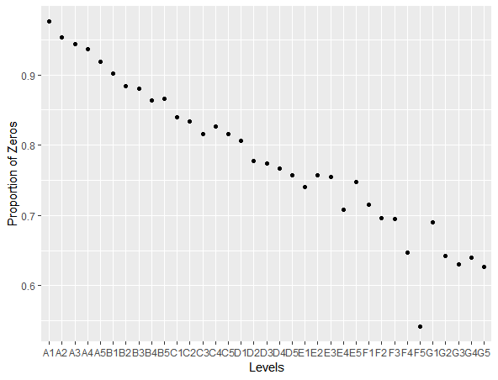
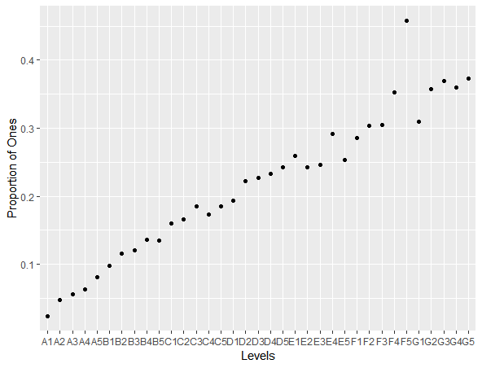
Exploratory Analysis
Notes:
Dom
Steady differences in proportion of zeros and ones show interaction

Slide 7
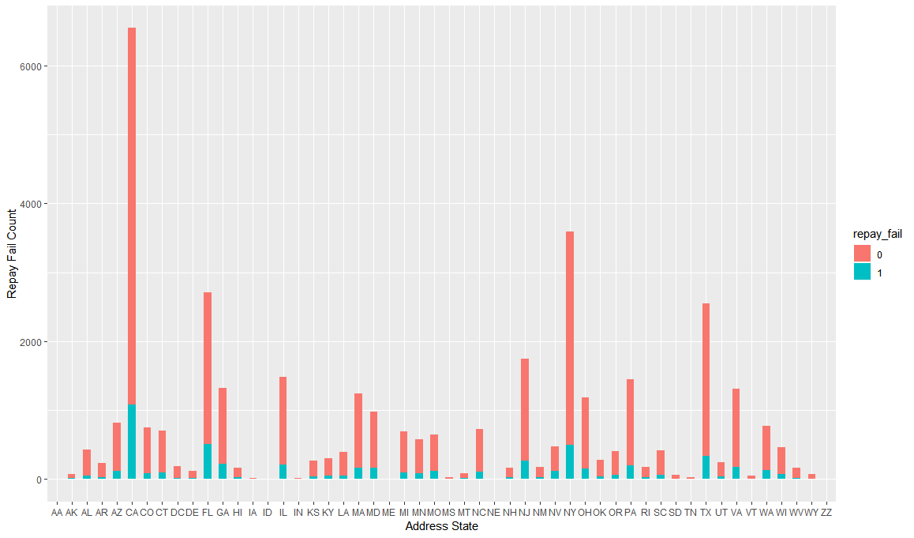
Exploratory Analysis
Big disparity in numbers of data points across different states
Removal would mean no geographical bias
Notes:
Dom
Talk about geographical bias if necessary

Slide 8
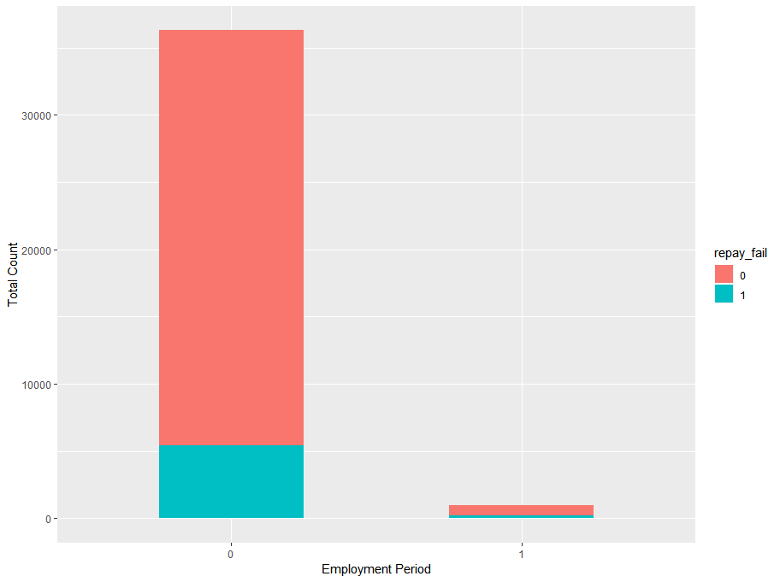

Exploratory Analysis
Notes:
Dom
Changed to dummy variable (0,1) as we had too many conditions: never employed, employed falling into 10 categories which were not evenly dispersed
Looking at proportion table, ...

Slide 9
Variable Selection
Treat, transform and restructure the data
Correlation plot between variable
Information Value - check for multicollinearity between variables
Fitting single variables in to the model, to test what’s the impact of the variable in predicting
Variable importance
Notes:
\ how we transform and restructure the data and a couple method based one our understanding that we used for variable slection
Variable importance: https://aichamp.wordpress.com/2017/03/26/variable-importance-and-how-it-is-calculated/
Information Value : http://www.sthda.com/english/articles/39-regression-model-diagnostics/160-multicollinearity-essentials-and-vif-in-r/
Optimum Cuttoff: https://ncss-wpengine.netdna-ssl.com/wp-content/themes/ncss/pdf/Procedures/NCSS/One_ROC_Curve_and_Cutoff_Analysis.pdf (Optimum Decision Threshold)
Our objectives here is that, we will try to filter out unnecessary variables to our model

Slide 10
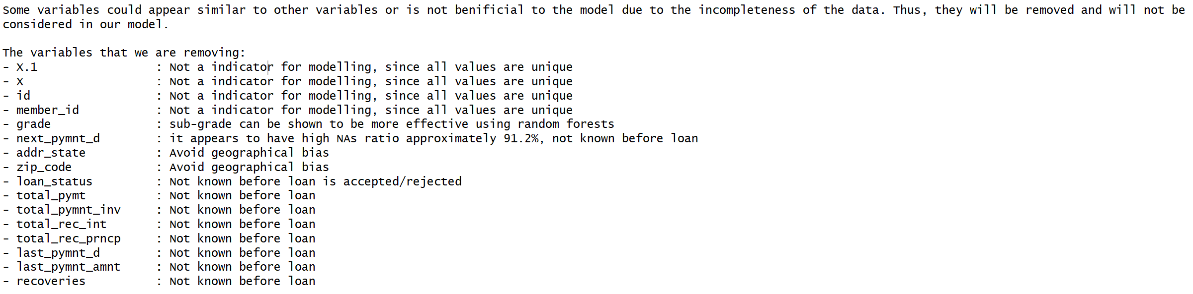
Unused variables
Variables that will not be consider in our model :
Notes:
Josh
Thanks Dom, just a heads up that the coming next 5 slides , I will talk about the ways how we treat the variables and remove unwanted variables, which essentially just not consider them into our model. This entire idea is to reduce as many unused variables as possible before running the model. so , based on our understanding of the data, these are the variables that will not be considered

Slide 11
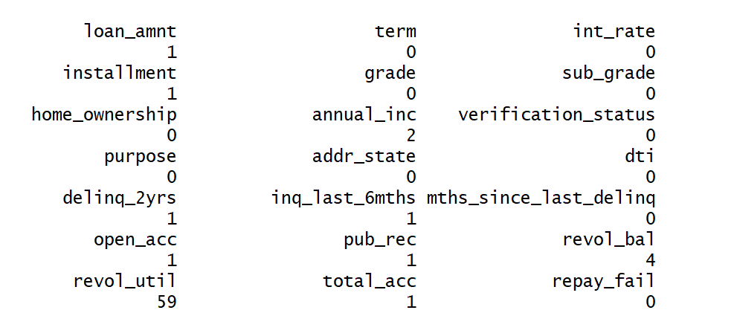
Transforming and Removing Data
Transform into date format, create a new variable credit_length,
Normalizing data on employment length, and standardized some variables such as delinq_2yrs and pub_rec has been coded into a dummy variable.
NA variables :
Notes:
Josh
We create a new predictive variable based on the available data , credit length which is denoted by the difference between earliest credit line and the issue date that the client have,
Why normalize data? To eliminate redundancy of the data
Why standardized data? In a way it able to reduce multicollinearity. Why is a problem? As it could hide statistical significant terms.
We decided to remove the entire row as we could not transform the missing data.
ADD log transformation on loan amount

Slide 12
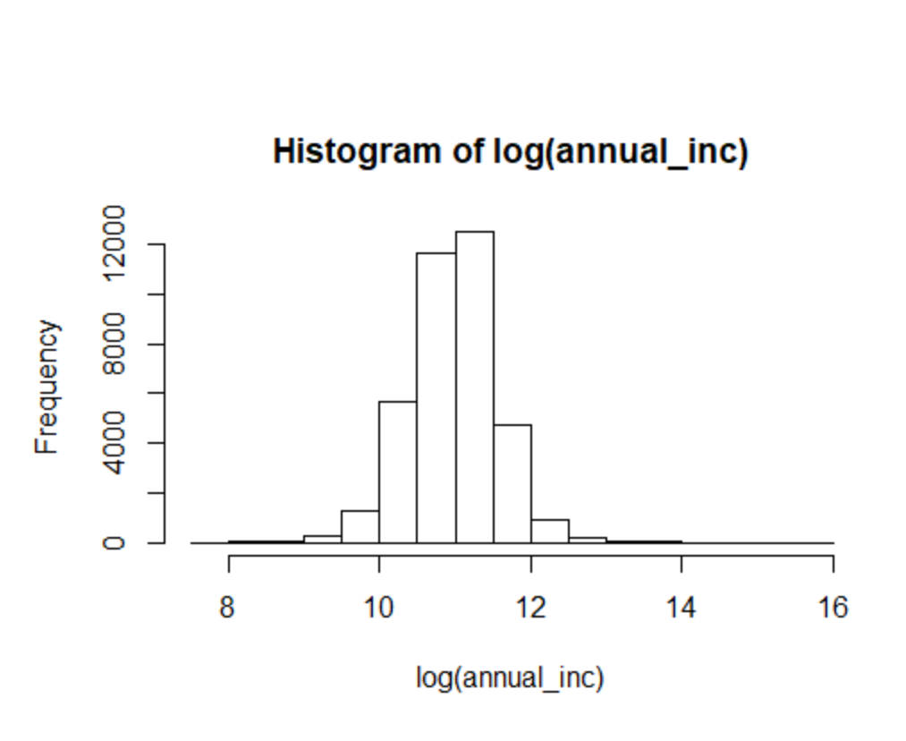
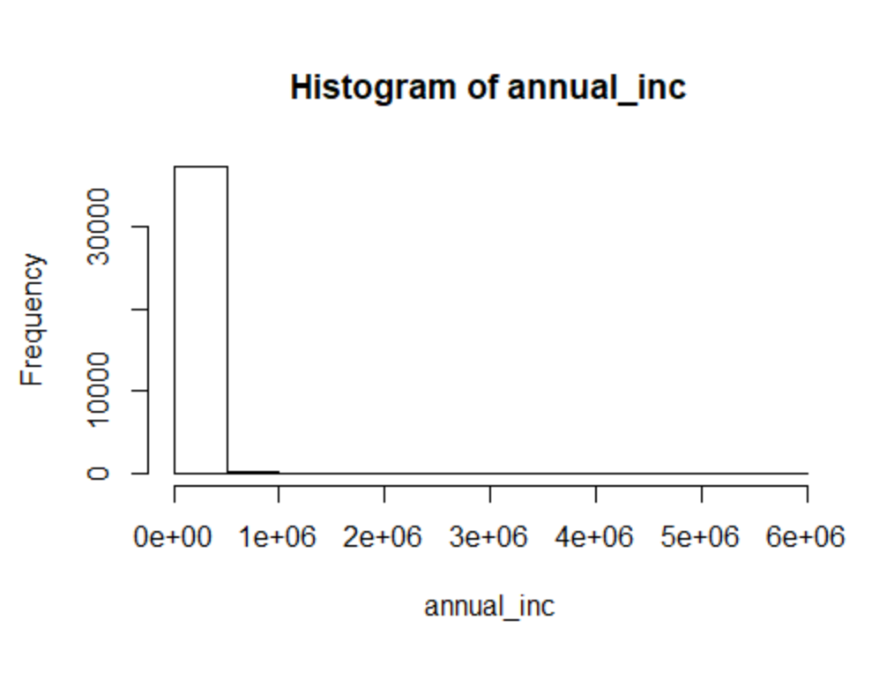
Transforming and Removing Data
Notes:
Log transformation
We did a log transformation on our annual income and loan amount variable, is just to improve the interpretability of the variable

Slide 13
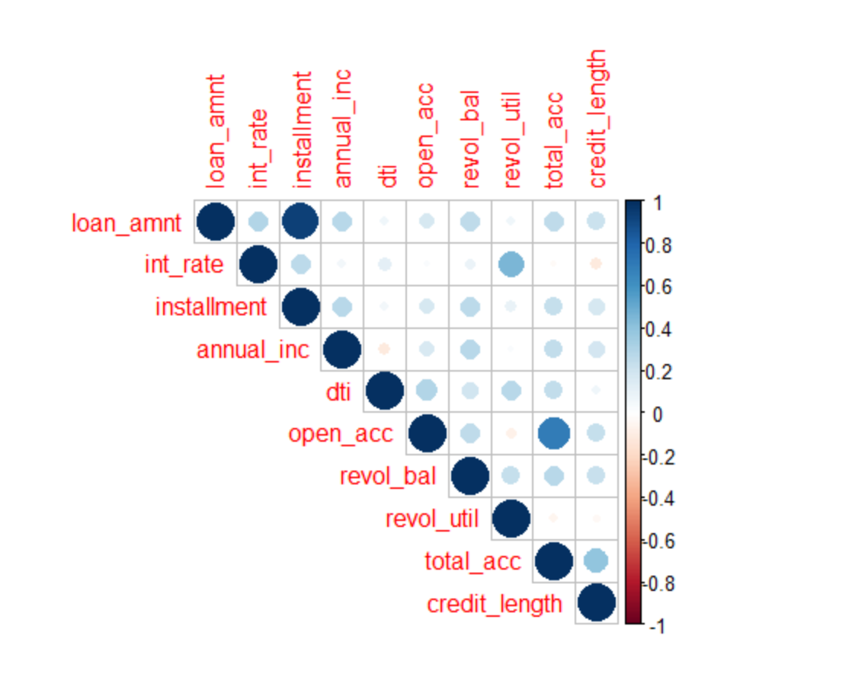
Variables Selection
Correlation between numerical variables
Either one of the variable will be use if they are correlated
Loan amount - installment, open acc - total acc
Installment and open acc will not be used
Threshold any correlation > 0.65 will be removed
Notes:
Mentioned splitting train and test 0.7
Josh
We set our threshold as any variables that has a correlation more than 0.65 will be removed

Slide 14
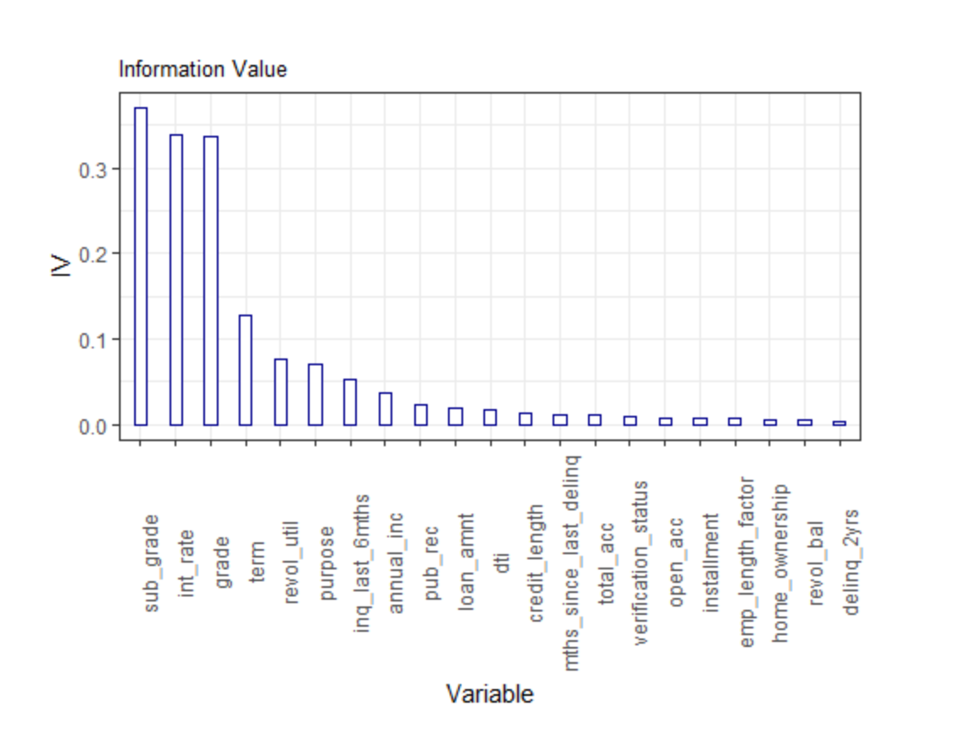
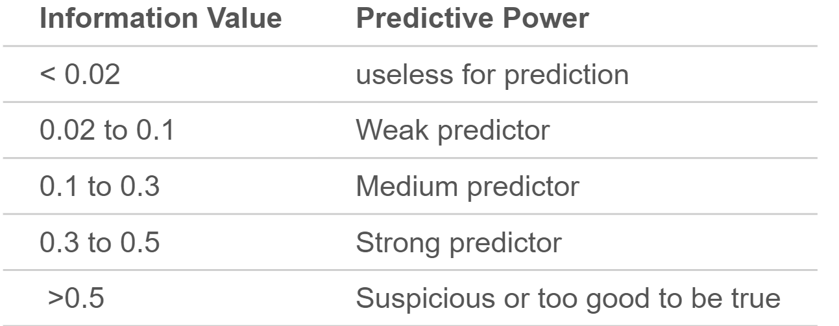
Information Value of Variables
Fit all the variables that are chosen into the model. Information Value tells us the importance of the variable plays in the model.
Notes:
Josh
Intro information value- we then develop a credit scorecard for the chosen variables by fitting them into GLM model and determine by information value. This is one of very useful concept for variable selection during model building.
This give us a rough idea what are the variables we would expect to be in our model

Slide 15
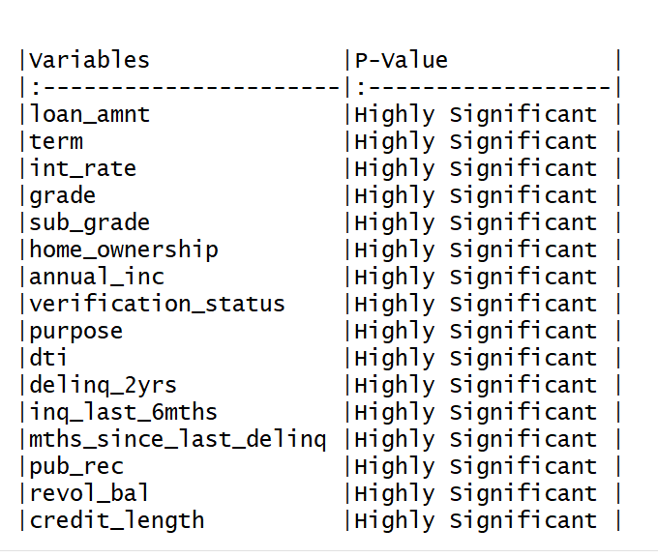
Fit single variable into the model
To determine whether the variables are still significant and have an impact to the model. By checking the p-values <0.05.
Notes:
In here we try to fit every single variable into the model to determine the impact the variable does to predict the repay fail alone. The rule of thumb here is that the coefficients and p-value will be determine. It appears that they are significant to the model. Since they are no variables to be removed we will proceed couple of model selection method

Slide 16
Model Selection
StepAIC
Random Forest
Lasso
Notes:
Josh
We split them into training and testing set 70 - 30

Slide 17
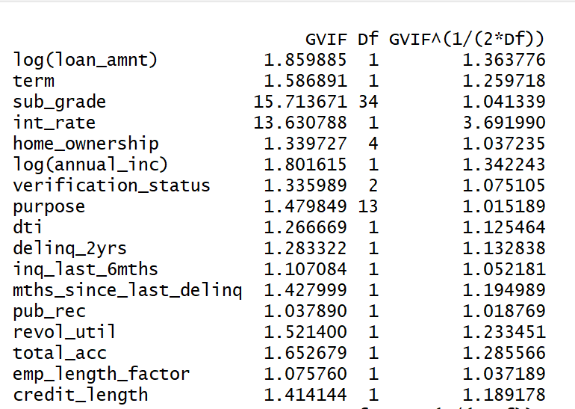
Method : StepAIC
Step 1: Fit a null model
Step 2: Check for multicollinearity, GVIF>5 or 10
Step 3: Run stepwise regression on forward and backward direction
Step 4: Summarize the model, remove any insignificant variables
Notes:
Josh
Multicollinearity why? As it undermine the statistical significance of an variable

Slide 18
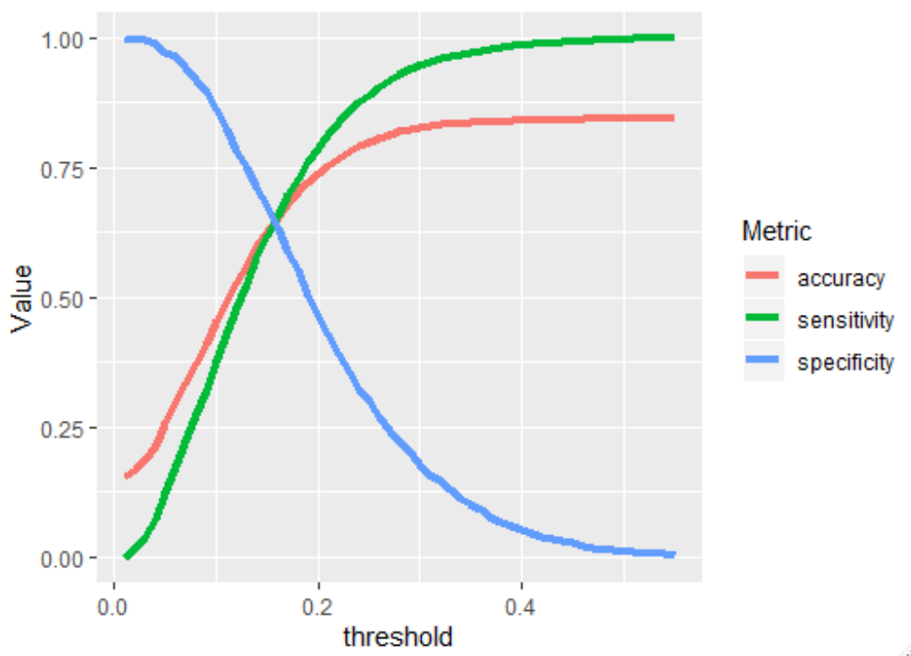
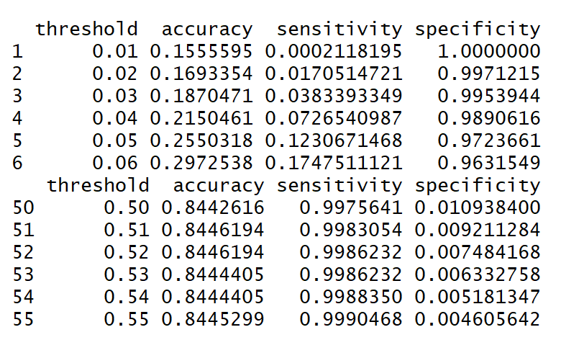
Method: StepAIC
Optimal Cutoff threshold for ROC curve, p = 0.55
Notes:
CHANGE
Add cloglog and probit link function
We ran a function call optimalCutOff , what it essentially does is that it will get the fitted value of our model and compare the actual data form the test to determine a sweet spot for the threshold to predict as much and accurate on people who actually default and people who will not default. As this will give us the best accuracy out form the model. As you can see we are trying to find the perfect threshold to cover the highest spec and sens

Slide 19
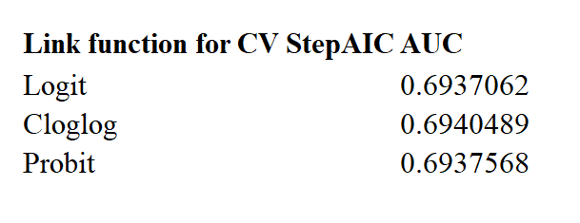
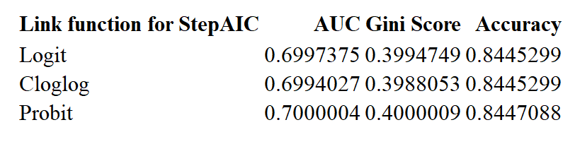
Validating Model
Notes:
Probit has the highest Gini score and accuracy

Slide 20
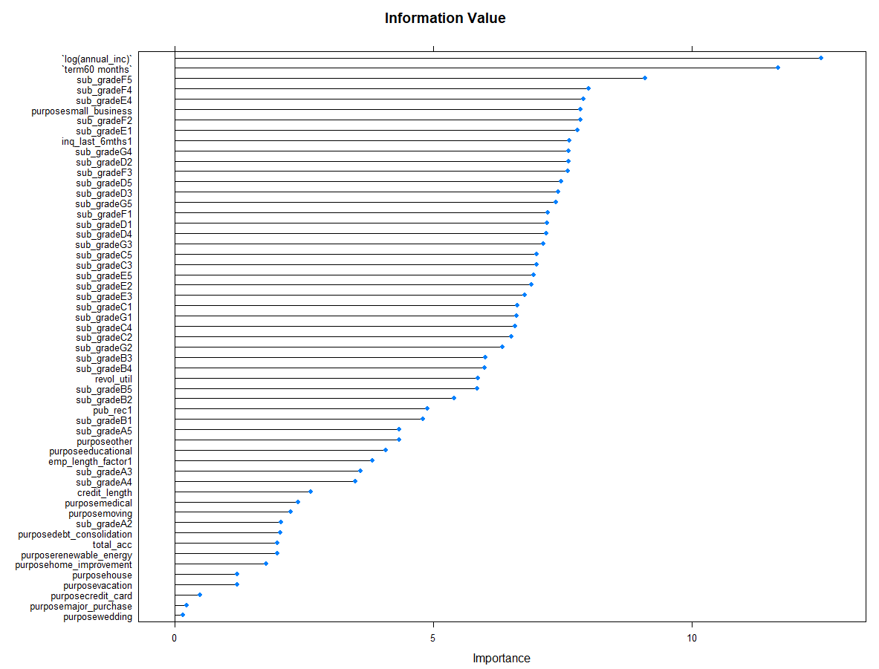
CV , 10 - folds
Notes:
Final stepAIC model information value

Slide 21
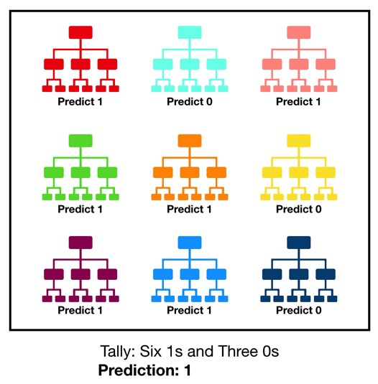
Model Selection: Random Forest Variable Selection
Issue: Wholesale inclusion of interaction terms can lead to overfit (Gayler, 1995)
Solution: Random Forests
A large number of individual decision trees that operate as an ensemble
Decision trees have low correlation, which protects the overall model from their individual errors
Random Forests can detect interactions between variables which can add predictive value
Especially important for affordability variables
Notes:
joe

Slide 22
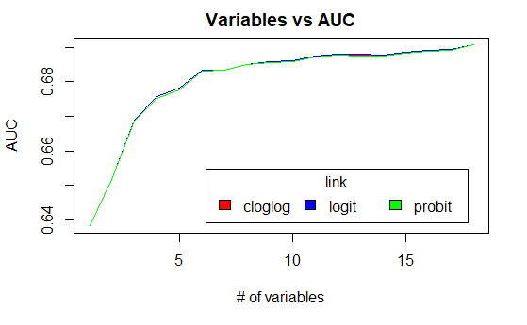
Method: Random Forest
How many variables to use?
5-fold cross validation
Run Random Forest on training fold - (using cforest)
Take variable importance matrix
Add variables to model in order of importance
Use variables that add to 95% of the total importance
Use this method on the full training set
Validate on test set

Slide 23
Model Selection: Lasso
A form of penalised logistic regression
Model is penalised for holding too many variables
Attempts to optimise AUC
Cross validates model to find optimal penalty to minimise variables
Run logistic regression on remaining variables
Notes:
Joe

Slide 24
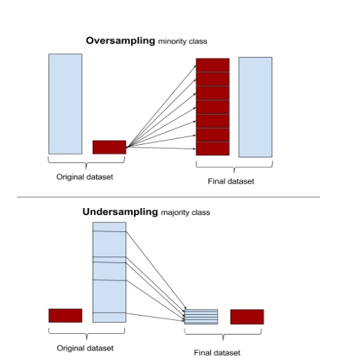
Attempting to Fix Class Bias
Upsampling/Oversampling
Samples with replacement from the minority class until the class distributions are equal
Retains all information
Downsampling/Undersampling
Samples without replacement from the majority class until the class distributions are equal

Slide 25
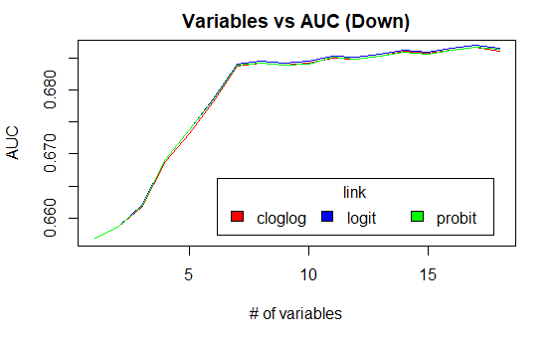
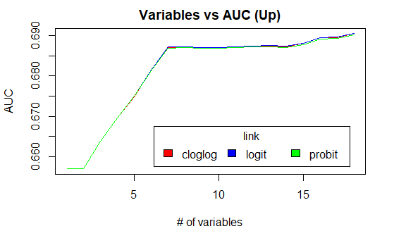
Up/downsampling
Used Random Forest Variable Selection
Used both up and downsampled data

Slide 26
Discussion
ROC
Gini
Confusion Matrix
Notes:
Joe

Slide 27
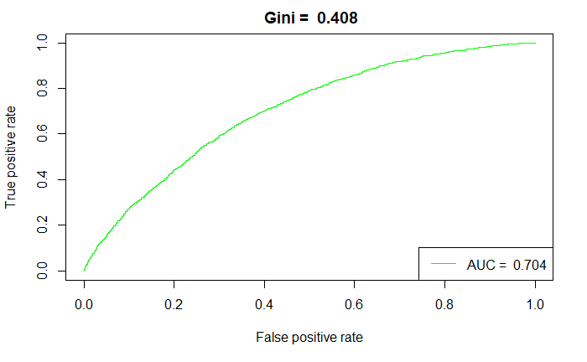
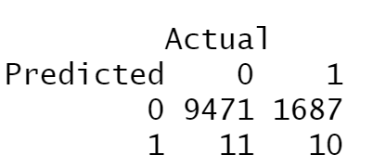
Model Selection - StepAIC

Slide 28

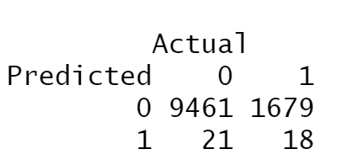
Model Selection - Random Forest

Slide 29
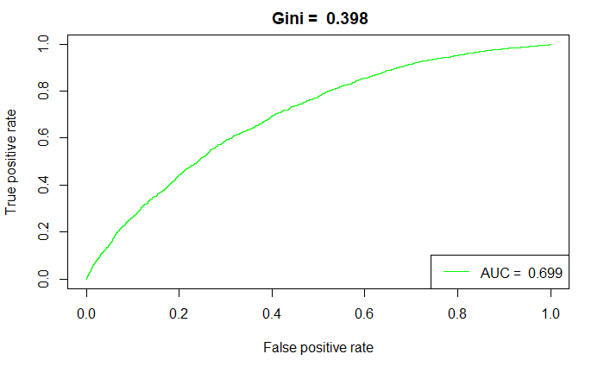
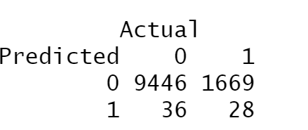
Model Selection - Lasso

Slide 30

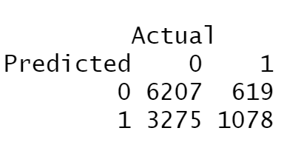
Model Selection - DownSampling

Slide 31

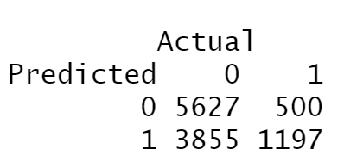
Model Selection - UpSampling

Slide 32
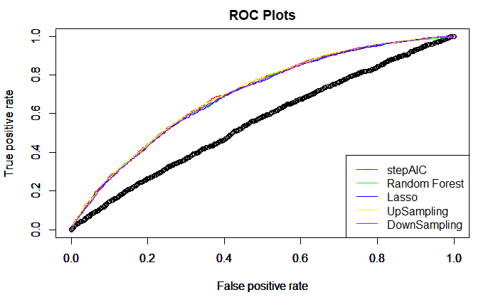
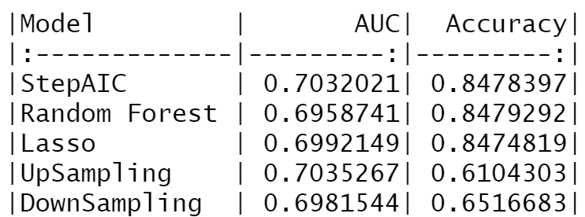
Model Selection
Notes:
Plot ROC with the given ROC

Slide 33
Final Model
Link Function:
Probit
Variables:
Term
Sub_grade
log(Annual_inc)
Purpose
Inq_last_6mths
Pub_rec
Revol_util
Total Account
Emp_length_factor
Credit_length
Notes:
Vinnie

Slide 34
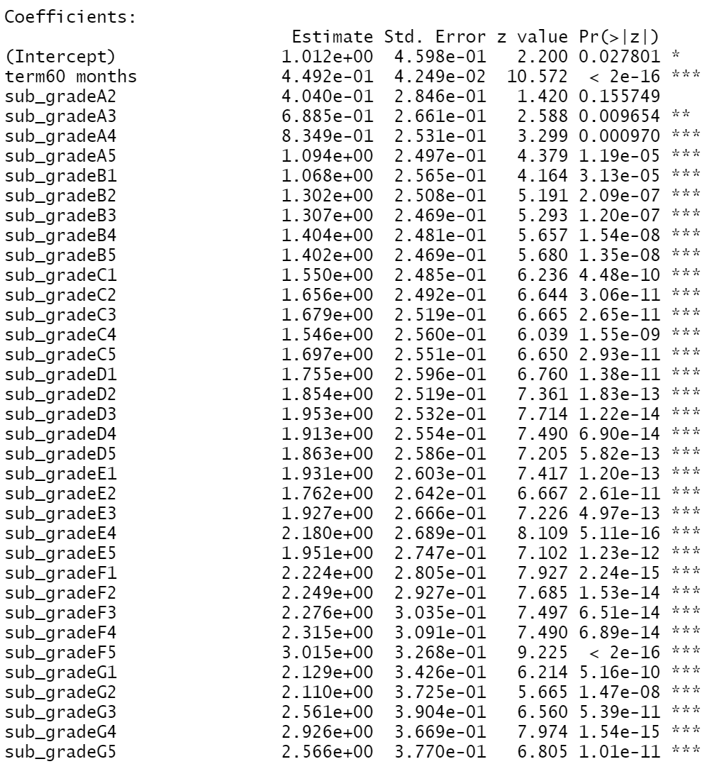
Results

Slide 35
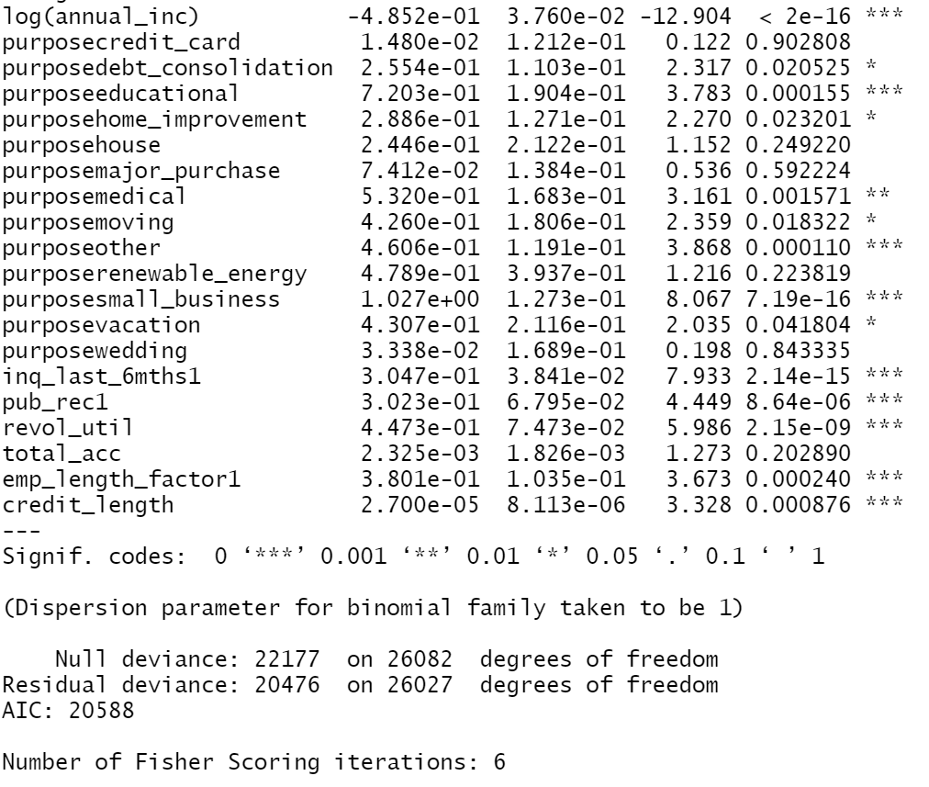
Results

Slide 36
Recommendation
Work more on classifying data
Restructure some variables by combining related variables
Reject Inference method into the model
Better treatment for missing data
Further action on threshold in business perspective
Predicts non-defaulted = Earning
Predicts defaulted = avoiding Loss

Slide 37
Conclusion

Slide 38
Q&A

